Slide 1
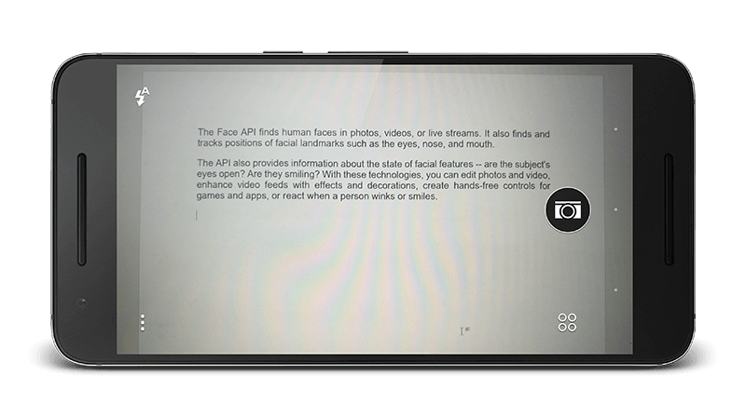
Text Reader
- Text recognition module for visually impaired individuals
- Improves quality of life for visually impaired users
- Adaptable module recognizes various languages, fonts, sizes, and orientations
- Versatile tool for enhancing accessibility in diverse contexts
- Powerful solution for breaking down barriers and fostering a more inclusive society

Slide 2
Modular Decomposition
Stage 1: Preprocessing
Objective: Prepare EMNIST dataset for training 3-layered CNN architecture
Steps:
Removing N/A Labels: Eliminate instances with missing or not applicable character labels
Normalization: Normalize pixel values to a range of 0 to 1 for improved numerical stability
Data Augmentation: Apply rotation and lighting adjustments to enhance model robustness
Reshaping & Grayscale Conversion: Convert images to grayscale and reshape to match CNN input dimensions
Dataset Splitting: Divide preprocessed dataset into training, validation, and testing subsets using stratified sampling
Outcomes:
Clean, accurate data for model training
Improved model resilience to various transformations and real-world scenarios
Preprocessing
3 layered Custom CNN
Post-processing and Text Output

Slide 3
Modular Decomposition
Stage 2: 3 layered Custom CNN
EMNISTNet CNN Architecture
Custom CNN architecture for character recognition using PyTorch framework
Components:
Convolutional Layers: Detect and combine low-level to complex features
conv1, conv2, conv3 with increasing output channels
Batch Normalization Layers: Improve convergence and generalization
bnorm1, bnorm2, bnorm3 applied after each convolutional layer
Fully Connected Layers: Form abstract representation and classify images
fc1, fc2, fc3 with decreasing output sizes
Dropout Layers: Prevent overfitting (dropout rate: 0.5)
dropout1 and dropout2 after fc1 and fc2
Preprocessing
3 layered Custom CNN
Post-processing and Text Output

Slide 4
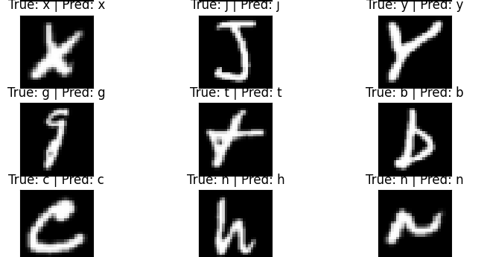
Modular Decomposition
Stage 2: 3 layered Custom CNN
Activation Functions and Training Process
Activation function: Replace ReLU with Leaky ReLU to avoid "dying ReLU" problem
Training process:
Train for 30 epochs using Adam optimizer (learning rate: 0.0005) and ReduceLROnPlateau scheduler
Minimize categorical cross-entropy loss with backpropagation
Record training and test errors and losses for performance evaluation and model selection
Outcome: Robust character recognition model with improved convergence and reduced overfitting
Preprocessing
3 layered Custom CNN
Post-processing and Text Output

Slide 5
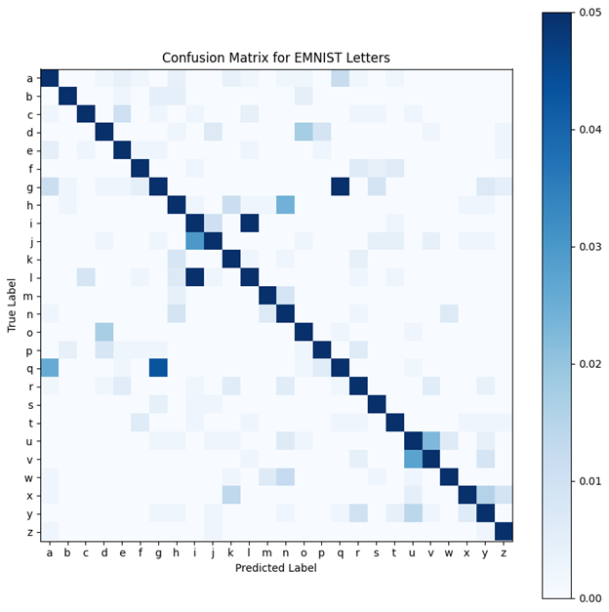
Modular Decomposition
Stage 2: 3 layered Custom CNN
26x26 grid plot: Rows are true labels, columns are predicted labels, color indicates prediction proportion
Ideal classifier: Diagonal dark blue cells (high correct predictions), light blue cells elsewhere (low incorrect predictions)
Preprocessing
3 layered Custom CNN
Post-processing and Text Output

Slide 6
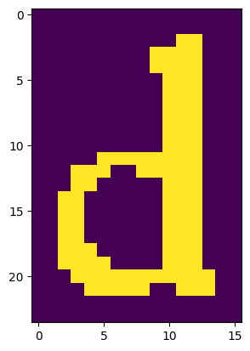
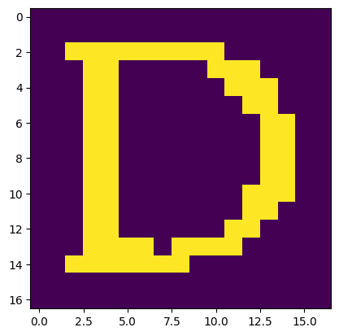
Modular Decomposition
Stage 3: Post-processing and Text Output
Objective: Predict characters from document images using trained CNN model
Key steps:
Preprocess images
Add padding
Segment images into lines and characters
Skeletonize and resize characters
Recognize characters and extract text
Preprocessing
3 layered Custom CNN
Post-processing and Text Output

Slide 7
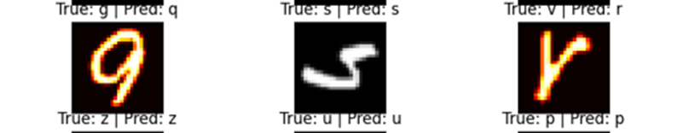
System testing and Verification
Preprocessed EMNIST dataset
Trained model for 25 iterations
Achieved 93.5% accuracy
Confusion due to similar letter shapes (e.g., "v" and "r", "g" and "q")
Model performs well overall, recognizing majority of characters

Slide 8
Limitations
Key constraints affecting Text Reader model:
Limited character set
Sensitive to image preprocessing
Inability to handle distorted or noisy text
Lack of context
No support for different languages
Computational complexity
Lack of rotation and scale invariance

